Slide 1
capstone project ONLINE PAYROLL SYSTEM

Slide 2
CSA0488-OPERATING SYSTEM
FACULTY NAME: DR. HEMAVATHI
GROUP MEMBERS:
K. MANJUNATH NAIDU
(192211469)
O. MAHESH KUMAR
(192211368)
O. MANOJ KUMAR
(192211370)

Slide 3
Problem Statement
1.Manual Data Entry and Error Reduction: Traditional payroll systems often rely on manual data entry, which is time-consuming and prone to errors. An online payroll system should automate the data entry process and include validation checks to minimize errors.
2.Compliance with Legal Requirements: Payroll systems must comply with various legal requirements, including tax laws and labor regulations. The system needs to be adaptable to changes in legislation and ensure that all payroll calculations are compliant.
3.Security of Sensitive Information: Payroll data includes sensitive personal and financial information. The online system must ensure the security of this data against unauthorized access, breaches, and other cybersecurity threats.
4.Integration with Other Systems: Payroll systems do not operate in isolation. They need to integrate seamlessly with other business systems, such as human resources management systems (HRMS), time tracking tools, and accounting software.
5.User-Friendly Interface: The system should be accessible to users with varying levels of technical expertise. A user-friendly interface and clear navigation are essential to ensure that payroll processing can be completed efficiently.
6.Real-Time Data Access and Reporting: Businesses need access to real-time payroll data for decision-making and financial planning. The system should offer comprehensive Compliance with Legal Requirements: Payroll systems must comply with various legal requirements, including tax laws and labour regulations. The system needs to be adaptable to changes in legislation and ensure that all payroll calculations are compliant.

Slide 4
Proposed Design Work

Slide 5
Functionality
•Automated Payroll Calculations
• Tax Calculation and Filing
•Direct Deposit and Payroll Checks
•Time and Attendance Integration
•Customizable Payroll Processing
Architectural Design
Presentation Layer: The user interface (UI) through which users interact with the system. It includes the employee self-service portal and administrative dashboard, designed for usability and accessibility.
Business Logic Layer: Contains the core functionalities and business rules for payroll processing, including calculations, deductions, tax compliance, and benefits management. This layer ensures that all payroll processes are executed accurately and efficiently.
A relational database management system (RDBMS) stores and manages all payroll-related data, including employee information, work hours, payroll transactions, tax information, and benefits data. The database is designed for integrity, with normalized tables to avoid redundancy and ensure data consistency.

Slide 6
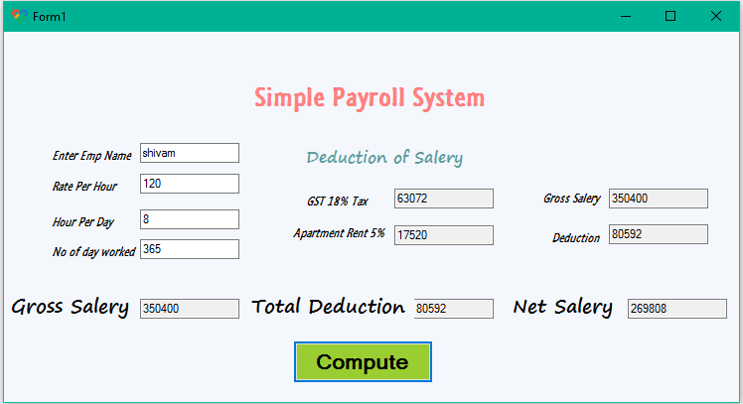
UI Design

Slide 7
Layout Design
User authentication page
Dashboard/home page
Employee management section
Payroll processing section
Reports section, setting/configuration section, support/help section, user testing and feedback
Feasible Elements Used
Authentication and security
Interface design
Data management and processing
Reporting and analysis
Notifications and alerts
Support and help section

Slide 8
Elements Positioning
Top navigation bar
Sidebar navigation (optional alternative to top navigation)
Employee management section
Payroll processing section
Reports section
Settings/configuration section, footer, consideration for positioning
Elements Function
Secures access to the system by verifying user credentials.
Provides a quick overview of the system's key metrics and notifications.
Allows for the addition, editing, and removal of employee profiles.
Enables the execution of payroll runs for specified periods.
Generates various reports related to payroll, taxes, and employee benefits.
Enables customization of system settings, including company profile and payroll settings.

Slide 9
Coding
#include <stdio.h>
int main() {
// Variable declarations
char employee­ Name[50];
float hours Worked, hourly Rate, gross Pay, taxRate, taxes, netPay;
// Input
printf("Enter employee name: ");
fgets(employeeName, 50, stdin); // Read string input including spaces
printf("Enter hours worked: ");
scanf("%f", &hoursWorked);
printf("Enter hourly rate ($): ");
scanf("%f", &hourlyRate);
printf("Enter tax rate (%%): "); // Use %% to print a single %
scanf("%f", &taxRate);

Slide 10
// Calculations
grossPay = hoursWorked * hourlyRate;
taxes = grossPay * (taxRate / 100.0); // Convert percentage to decimal
netPay = grossPay - taxes;
// Output
printf("\nPayroll Information:\n");
printf("Employee Name: %s", employeeName); // fgets includes the newline character in the input
printf("Gross Pay: $%.2f\n", grossPay);
printf("Taxes: $%.2f\n", taxes);
printf("Net Pay: $%.2f\n", netPay);
return 0;
}

Slide 11
Conclusion
In conclusion, designing an effective online payroll system requires careful consideration of both the layout and functionality of its various elements. From the initial user authentication page to the comprehensive dashboard, employee management, payroll processing, reports section, and beyond, each component plays a pivotal role in ensuring the system's usability, security, and compliance with legal requirements.
The positioning and function of these elements are critical in creating an intuitive user interface that facilitates easy navigation and efficient task completion. Implementing features such as responsive design, two-factor authentication, dynamic forms, and customizable reports can significantly enhance the user experience. Moreover, integrating feedback tools and providing robust support resources can help in continuously improving the system based on user input and changing regulatory environments.
Ultimately, the goal of an online payroll system is to streamline payroll processes, reduce administrative burdens, and ensure accurate and timely employee payments, all while safeguarding sensitive information. By focusing on the user's needs and leveraging modern web technologies, organizations can develop a payroll system that not only meets these objectives but also adapts to future challenges and opportunities in payroll management.

Slide 12


